Slide 1

COS 781 (Data Mining)
Theme 7
Decision Trees

Slide 2
What is a Decision Tree?
A basic tree data structure
  Internal nodes denote attribute tests
  Each branch from a node denotes a test outcome
  Leaf nodes denote classifications
Classification of new examples
  Start at the root of the tree
  Evaluate each test in turn
  Follow branch to next test
  Apply classification of leaf node finally reached
  No explicit default rule
  Therefore always ordered

Slide 3
What is a Decision Tree?
Why are decision trees useful?
  Their interpretation is intuitive
  They can be converted into a rule set

Slide 4
Building a Decision Tree
Builds a decision tree recursively
  A “divide and conquer” approach
    Start with a single node
    Define an attribute test
    Define a branch for each attribute test outcome
    Refine each branch of the attribute test
      Start by defining a new attribute test, then recursively refining again
      Use the subset of examples classified by the branch being refined
  Usually this is a greedy approach
    No backtracking to previous attribute tests
    What does this imply?

Slide 5

Building a Decision Tree

Slide 6
Building a Decision Tree
The most important decision we have to make
  How is an attribute test selected?
Additionally, we must consider
  When should a leaf node be created?

Slide 7
The ID3 Algorithm
Invented in 1986 by J. Ross Quinlan
Attribute test selection
  Only works with nominal attributes
  Consider each possible attribute
  Select best test based on information entropy
  Select attribute that maximises information gain
    is the entropy of the branch’s examples
    is the entropy after splitting the data set up
    according to the selected test

Slide 8
The ID3 Algorithm
Gain criterion has a bias
  Tends to select tests with many outcomes
  For example, a test based on ID number
  Why is this?
  Why is this a problem?
  How can we address this problem?

Slide 9
The ID3 Algorithm
When does the recursion stop?
  When a leaf node is generated
    Every element in the subset belongs to the same class
      Node becomes a leaf node predicting the class of the examples
    There are no more attributes to be selected
      May happen while examples in the subset are mixed classes
      Node becomes a leaf node predicting most common class of the examples in the subset
    There are no examples in the subset
      When no example in the parent subset match a the test outcome
      Node becomes a leaf node predicting most common class of the examples in the parent node's set

Slide 10
Further Reading
J. R. Quinlan. C4.5: Programs for Machine Learning. The Morgan Kaufmann Series in Machine Learning. Morgan Kaufmann, 1993.
J. R. Quinlan. MDL and categorical theories. In Proceedings of the Twelfth International Conference on Machine Learning, pages 464–470.
J. R. Quinlan. Improved use of continuous attributes in C4.5. Journal of Artificial Intelligence Research, 4:77–90, 1996.
J. R. Quinlan. Bagging, boosting, and C4.5. In Proceedings of the Thirteenth National Conference on Artificial Intelligence, volume 1, pages 725–730.

Slide 11
The C4.5 Algorithm
A more advanced tree building algorithm
  Evolved from the simple ID3 algorithm
  Designer and Implementer (circa 1993):
    J. Ross Quinlan
  Current version (revision 8)
    http://www.rulequest.com/Personal
  Originally commercial version (now free)
    See5 for Windows
    C5.0 for Unix

Slide 12
C4.5: Algorithm Output
C4.5 can handle continuous attributes
Primary output
  A decision tree
Can convert decision trees into rule sets
  An ordered rule set
  Post processing phase on a decision tree
  More on this later…

Slide 13
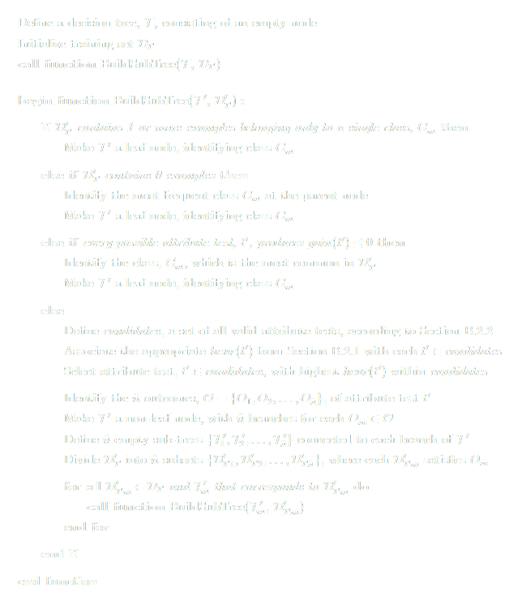
C4.5: Algorithm Overview
Recursively called to refine every sub-branch
Branch classifies only a single class of example
Branch’s outcome classifies no examples (i.e. no examples have that attribute value)
Every attribute test is insignificant
Branch requires refining
Create a new branch and node for each test outcome
Based on branch outcomes, divide the parent node’s training data between the sub-nodes, and recursively refine each of them in turn

Slide 14
C4.5: Heuristics
Used to measure how optimal an attribute test is, before selecting one
  Based on the entropy measure
    Average amount of information needed to identify class of a case in a training example set
    Based on the number of examples in each class within an example set
  See further reading...

Slide 15
C4.5: Heuristics
C4.5 supports the older gain criterion
  An option that must be explicitly invoked

Slide 16
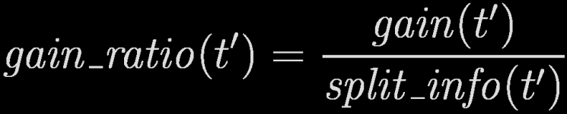
C4.5: Heuristics
Replace gain with gain ratio criterion
  This is a normalised gain measure
  The split_info term
    Measures information that can be potentially created by splitting D′_{T} into n subsets
    Based on number of examples in the subsets
  See further reading…

Slide 17
C4.5: Candidate Tests
Attribute test with highest gain or gain ratio is “optimal”, and is thus selected
BUT, gain and gain ratio require a set of test outcomes for their calculation
THUS, a series of candidate tests are proposed for each node expansion
One candidate test (with n outcomes) proposed for each attribute

Slide 18
C4.5: Candidate Tests
Types of candidate tests
  Discrete attribute tests
    One outcome per possible attribute value
      Each O_{i} equivalent to an attribute value
      n = number of attribute values
    Outcomes for grouped values
      Each O_{i} may refer to a single attribute value, or two or more grouped together
      n ≤ number of attribute tests
      Greedy search determines optimal groups (highest heuristic)
  Continuous attribute tests
      Candidate thresholds determine possible tests
      n = 2 (1st for values ≤ threshold, 2nd for values > threshold)
      Threshold producing highest heuristic selected

Slide 19
C4.5: Additional Features
Tree pruning
  Retrospectively remove some tree structure
  More compact and understandable trees
  Replace a sub-tree with a leaf node
  Replace a sub-tree with one of its branches
  Uses a pessimistic estimate of error rate at a node
  Prunes nodes that reduce the error estimate
Missing value replacement

Slide 20
C4.5: Additional Features
Windowing
  Training example window
  Train a tree on the examples in the window
  Classify the examples outside of the window
  Add “problem cases” to the window
  Repeat until all examples are classified correctly
See further reading for more details…

Slide 21
C4.5: From Trees to Rules
Translates a tree to a rule set
  Based on an un-pruned tree

Slide 22

C4.5: From Trees to Rules
Initial translation
  A simple trace from root to each leaf
  Each trace produces one rule
  Problems?

Slide 23
C4.5: From Trees to Rules
We need to simplify the initial rule set
  Step 1
    Prune unnecessary conditions
  Step 2
    Prune entire rules judged to be unnecessary
  Step 3
    Order the rules and add a default rule
  Step 4
    Prune unnecessary rules again

Slide 24

C4.5: From Trees to Rules
Step 1: Build a rule for each leaf node where consequent is leaf’s outcome
Condition becomes conjunct of test outcomes on a path from root node to leaf outcome
Step 2: Prune conditions judged as unnecessary (rule without condition produces no greater error than original rule)
Step 3: Prune rules within a class grouping to minimise the group’s Minimum Description Length (MDL) encoding
Step 4: Order rules in each class group (rules with fewer false positives placed first) and define default rule
Step 5: Prune rules again based on overall rule set classification performance

